Slide 1
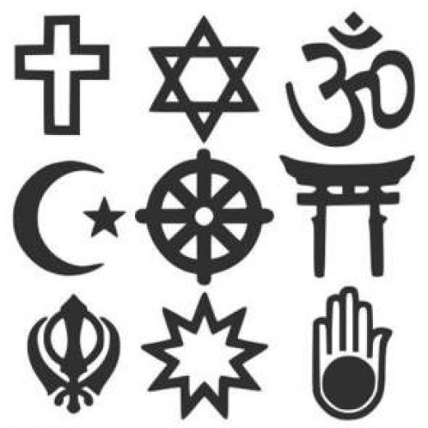
Ancient African Gods and Goddesses
A study of culture, society, and religion.

Slide 2
There are many different kinds…
A deity is like a god: all powerful.
African cultures have a mixture of deities and lesser spirits, such as the spirits of ancestors.
Most have a supreme god that is usually associated with the sky. In many African religions, however, this supreme god is a distant being no longer involved in day-to-day human life.
The people rarely call on this deity, and instead address lesser gods, many of whom have distinct functions.
The number of gods and goddesses varies from culture to culture.

Slide 3
A god, a spirit, and an ancestor are sitting next to each other on a plane…
COOL FACT
Spirits are invisible beings with powers for good or evil. Spirits are less powerful, less grand, and less like humans than gods (who often have weaknesses and emotions).
Many are associated with physical features such as mountains, rivers, wells, trees, and springs.

Slide 4
The dead rule the night…
Many Africans believe that human spirits exist after death.
Some believe that the spirits dwell in an underground world much like our own, only upside down. The spirits sleep during the day and come out at night.
Others place them in the sky. The Bushmen believe they become the stars.

Slide 5
The dead rule the night…
Many believe that ancestors remain close to their descendants to help and protect them…
So long as they preform certain ceremonies and due respect.
In some cultures, such as the Zulu, they preform certain ceremonies so that their ancestors may be reborn in a new baby.
It is also a common belief is that dead souls return as snakes, which many Africans regard with respect.

Slide 6
Next, I have some gods and goddesses to show you!
They are called “Orishas”, and they are AWESOME.
Notes:
The artist is named James C. Lewis, and he became inspired after he began researching African deities. He says the Orishas were his favorite.

Slide 7
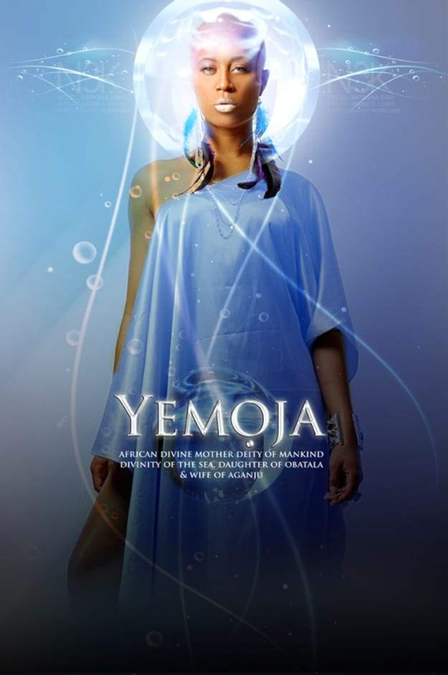

Slide 8
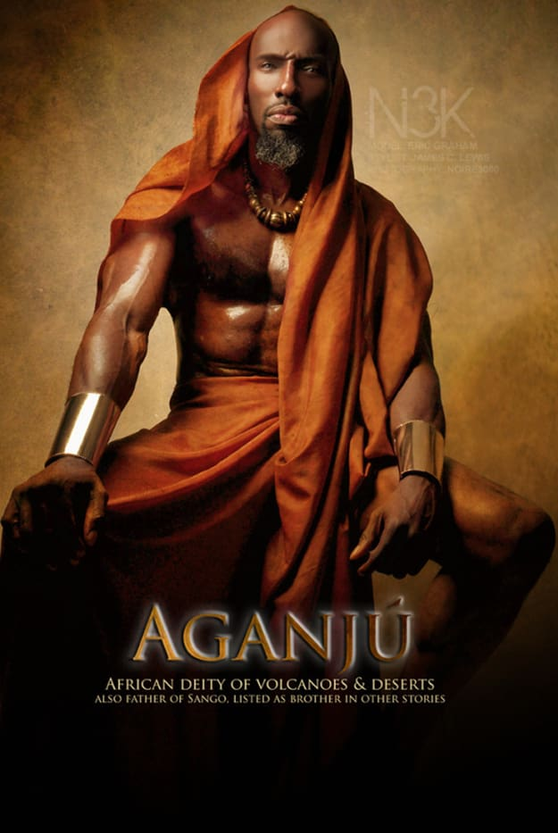

Slide 9
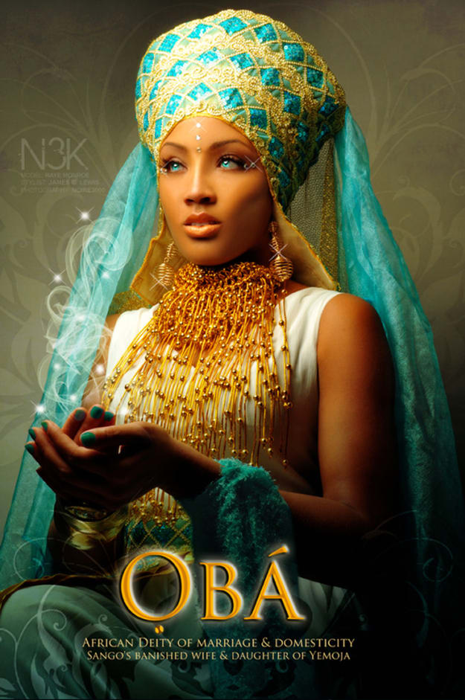

Slide 10
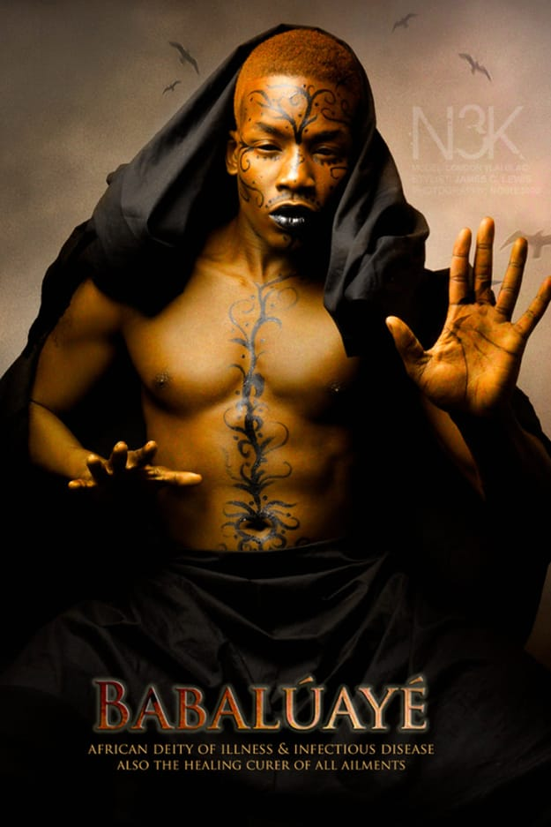

Slide 11
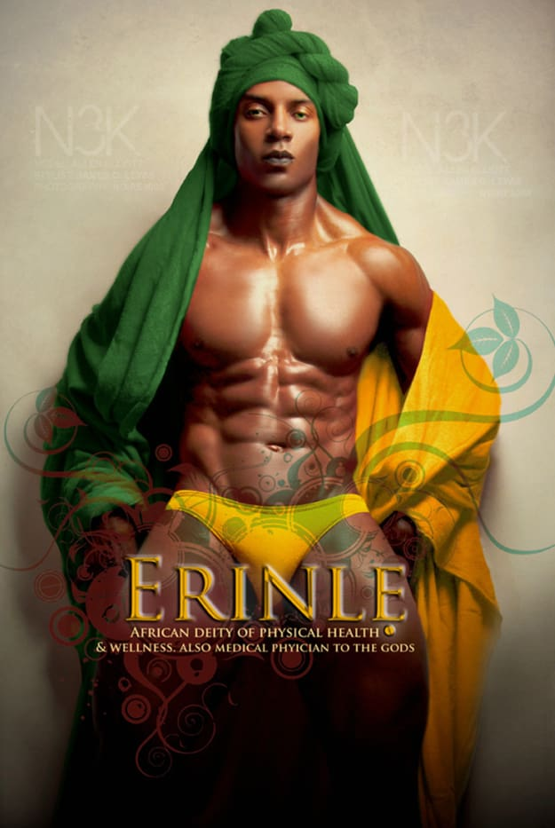

Slide 12
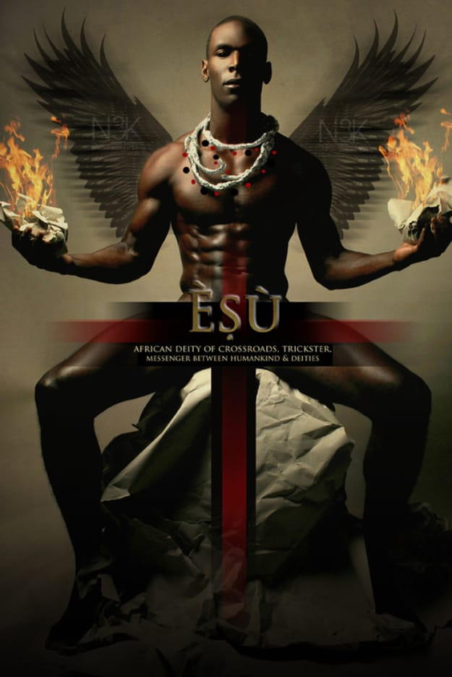

Slide 13
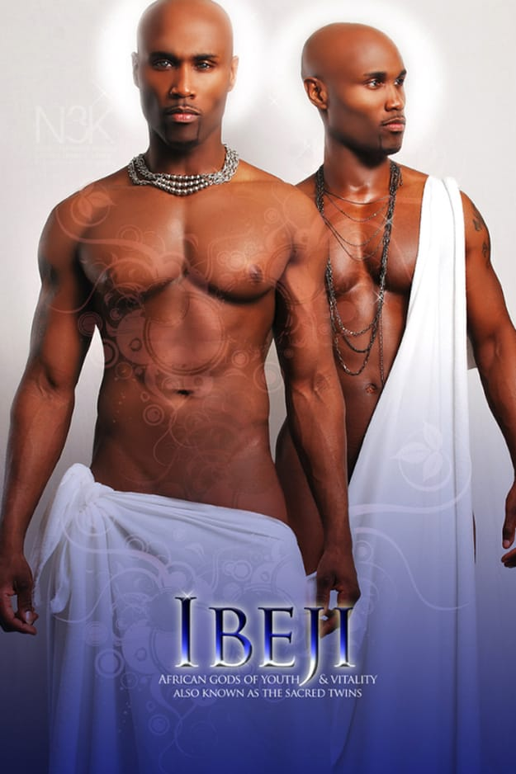

Slide 14
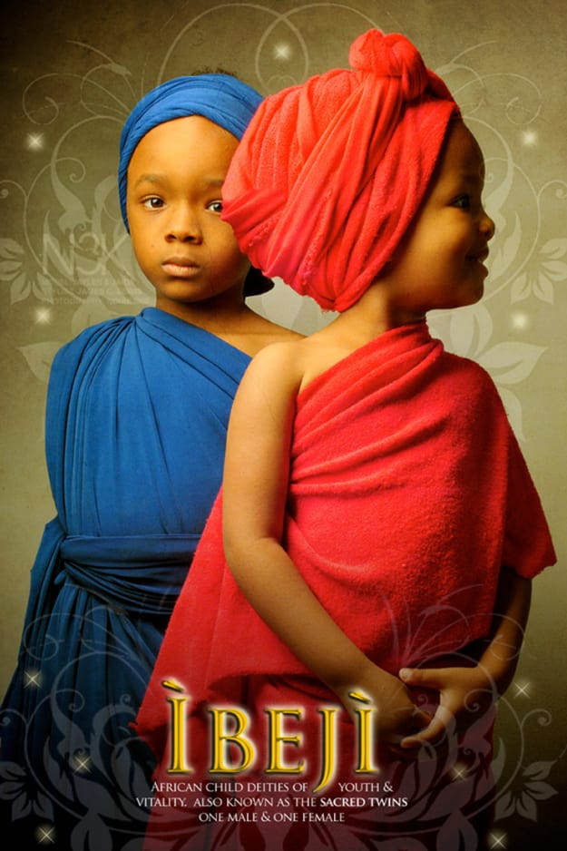

Slide 15
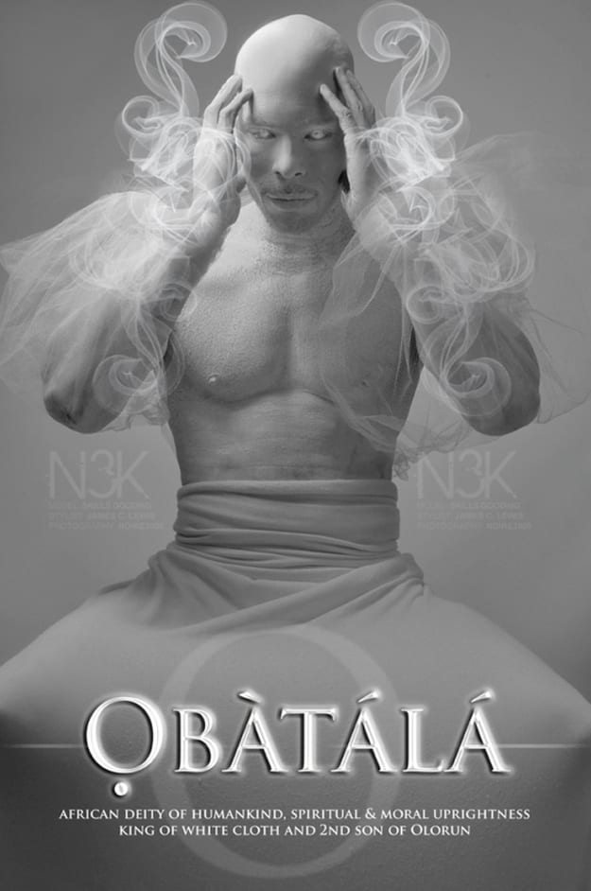

Slide 16
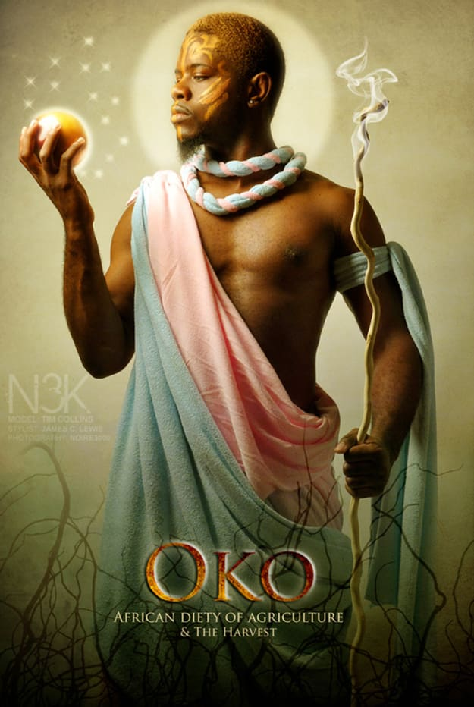

Slide 17
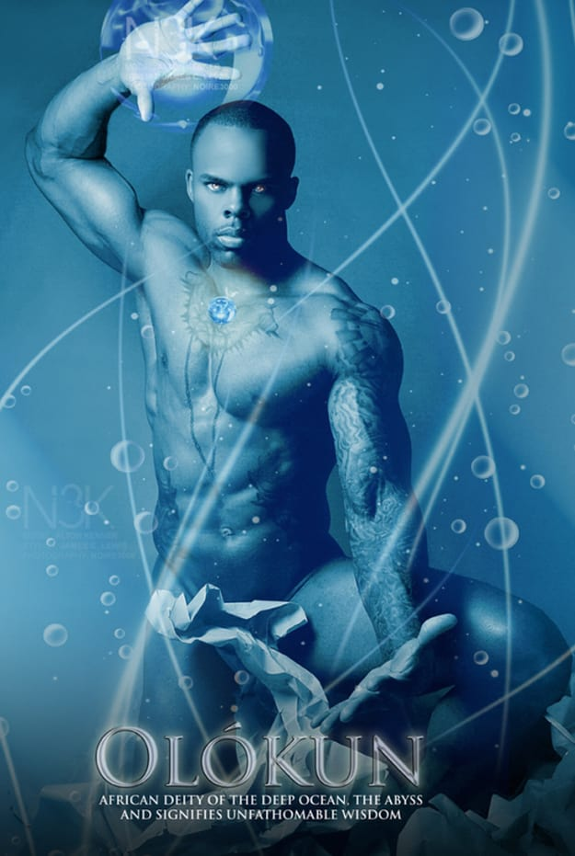

Slide 18
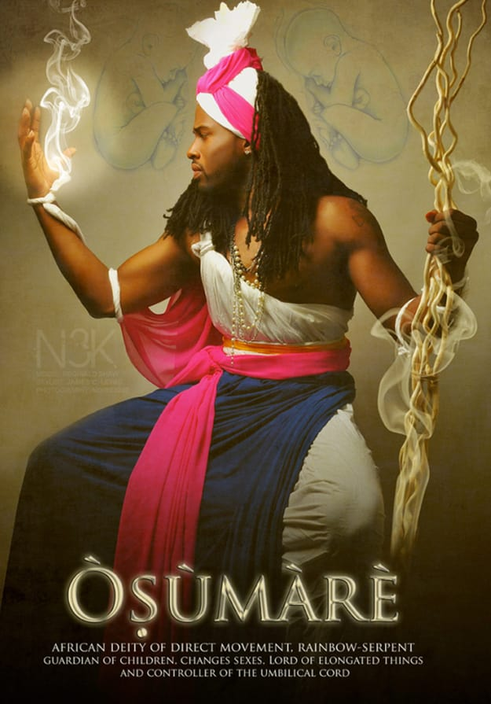

Slide 19
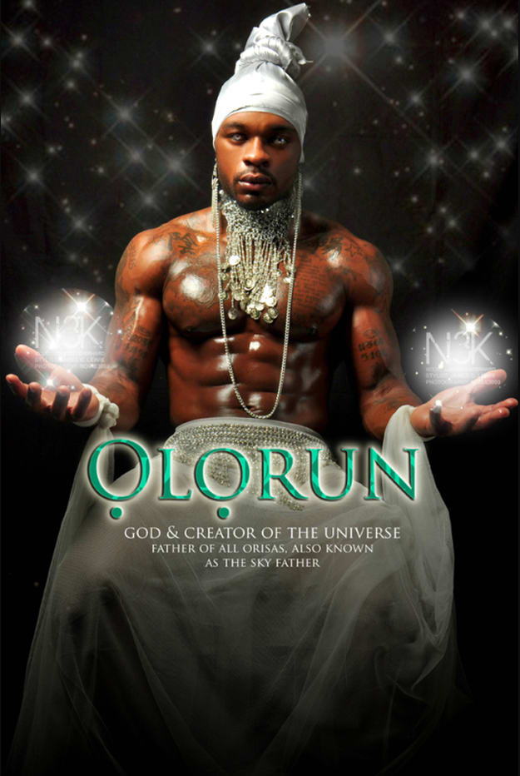

Slide 20
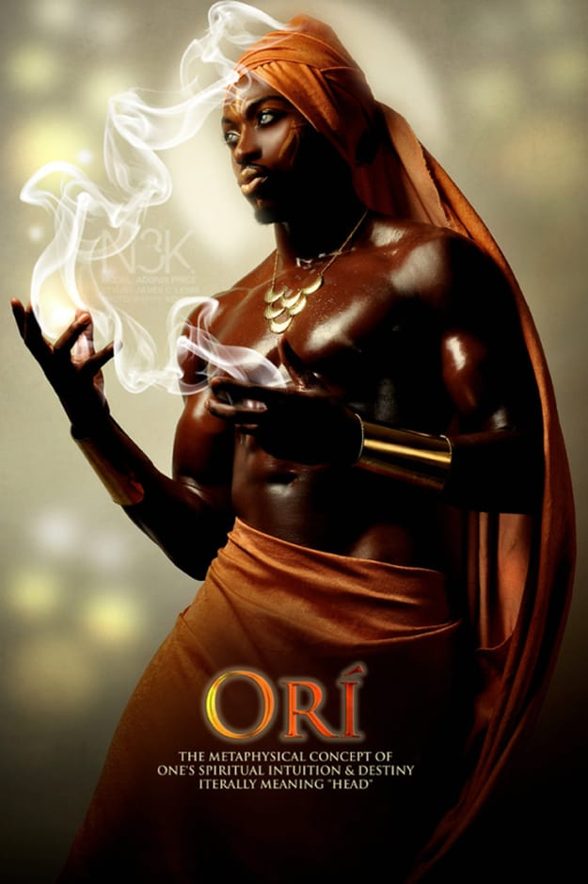

Slide 21
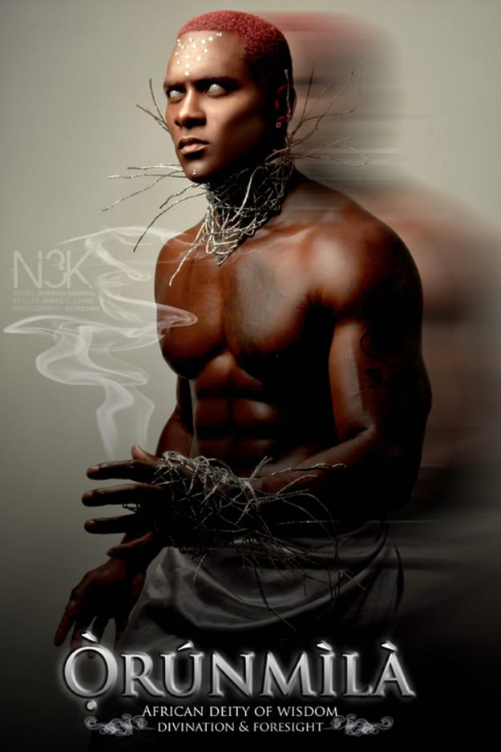

Slide 22
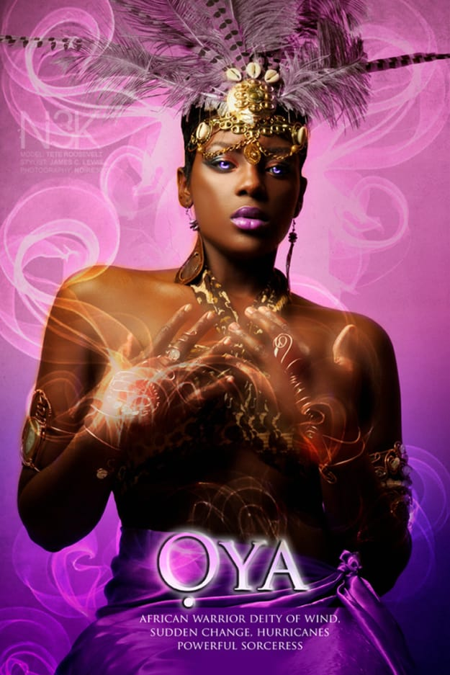

Slide 23
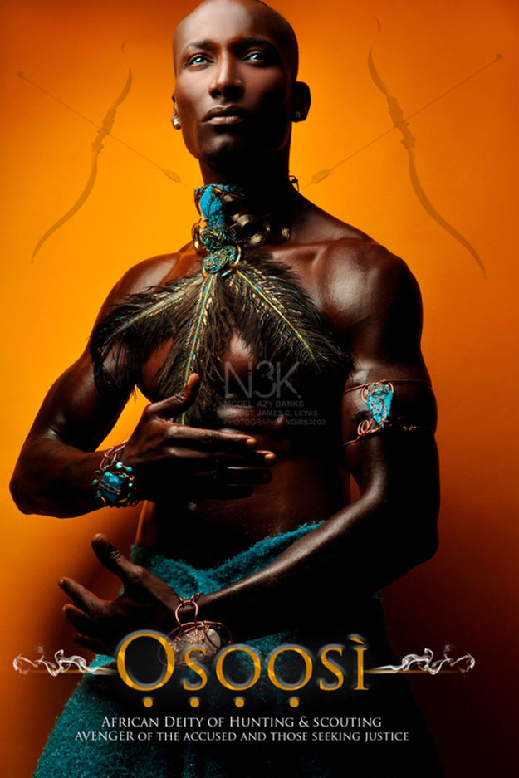

Slide 24
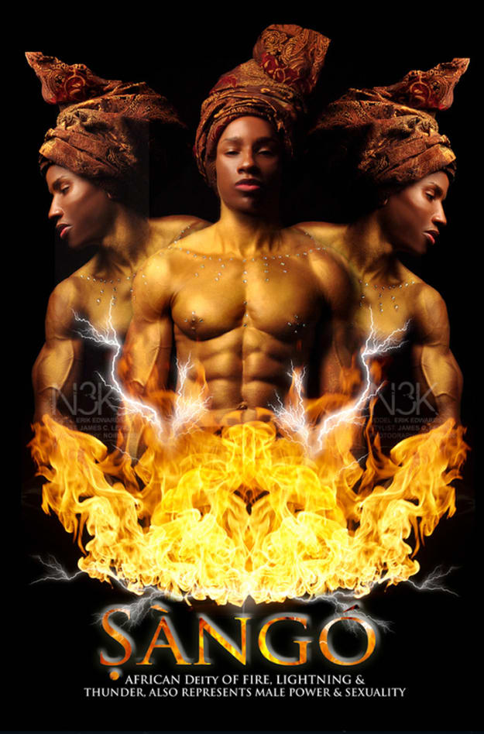

Slide 25
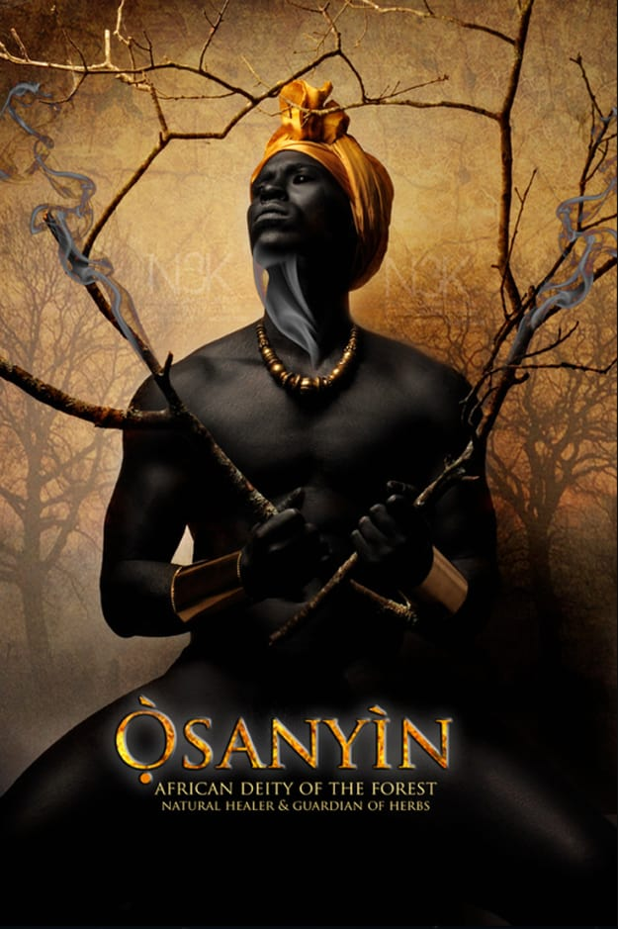

Slide 26
“Throughout my formal education from elementary through college I never heard tale of African deities. A little over a month ago I began to research online to find information in regards to the gods and goddesses of Africa. To my surprise there were many, however, the ones that stood out the most were the deities of Nigeria and Benin, West Africa which they refer to as the Orishas.
I wanted to portray the regal beauty of ach Orisha while also representing their majestic sensuality. Each iconic depiction was rendered to lend strength to our resilience as a great race of people and to show our youth that they are beautiful, bold, and brilliant just the way that God created them to be…each Orisha’s name is written in the Yoruba dialect and captures the imagery of powerful men, women, and children of various complexions who are all of African descent.”
Notes:
Creator James C. Lewis had this to say about his inspiration for the set.

